Slide 1
Review-1 on Hand gesture recognition using Deep learning
Bollineni Chooshnita 2010030487
Telugu Rohith 2010030201
Perla Nada Asish 2010030552
Under the Guidance of
Dr. Subhranginee Das
Asst.Professor
Computer Science and Engineering Department
KL Hyderabad Off Campus, Aziz Nagar ,Hyderabad

Slide 2
Overview
Introduction
Literature Review
Problem Statement
Objectives of the Project
Proposed Methodology/Architecture/Algorithm/Technique/etc
References

Slide 3
Introduction
Hand gesture recognition unlocks a level of natural human-computer interaction, unlike the limitations of keyboards or buttons. Imagine controlling robots or conveying information simply with intuitive hand movements.
Hand gestures are fundamental to non-verbal communication and crucial for environmental interaction. This technology holds immense potential for sign language users, particularly those deaf and dumb individuals who face communication barriers.
Sign language demonstrates the power of conveying ideas through distinct hand shapes and finger positions. Human-machine interaction utilizing these principles allows communication beyond spoken words, opening doors for new avenues of expression and understanding.
By enabling efficient communication through hand gesture recognition, this technology can empower the deaf and dumb community, granting them a more active role in society and improving their overall quality of life.
This technology transcends traditional input methods, pushing the boundaries of human-machine interaction. It paves the way for a future where we communicate and control technology with the same natural ease as we do with each other.

Slide 4
Literature Review
 | Authors | Title | Source | Date
1 | Marc Marschark and Patricia Elizabeth Spencer | The Oxford Handbook of Deaf Studies, Language, and Education, Vol. 1, 2nd ed. | Oxford University Press, 2011 | -
2 | N. Dhruva, Sudhir Rupanagudi, and H. N. Neelkant Kashyap | Novel Algorithm for Image Processing based Hand Gesture Recognition and its Application in Security | Third International Conference on Advances in Computing, Communication, and Control (ICAC3), Communications in Computer and Information Science, Volume 361, pp. 537 – 547 | January 18-19, 2013
3 | Shu Mo, Shihai Cheng, and Xiaofen Xing | Hand gesture segmentation based on improved Kalman filter and TSL skin color model | International Conference on Multimedia Technology (ICMT), pp. 3543 – 3546, 2011 | -

Slide 5
Problem Statement
Develop a system for real-time hand gesture recognition, enabling intuitive human-computer interaction across diverse applications.
The system should accurately identify and interpret a variety of hand gestures captured through a camera feed.
Emphasis lies on achieving robustness to environmental factors like lighting changes and background complexity, while ensuring efficiency for real-time performance on hardware-constrained platforms.
The goal is to create a reliable tool for applications such as sign language translation, virtual reality interfaces, and interactive presentations, enhancing accessibility and user experience in digital environments.

Slide 6
Objectives of the Project
Gesture Recognition: Detect and recognize different hand gestures accurately and Develop a system that can interpret the meaning of each gesture.
Real-time Processing: Achieve real-time processing for prompt and responsive interaction. Optimize algorithms and models to ensure low latency, enabling the system to quickly respond to changes in hand gestures.
Multimodal Integration: Explore the integration of multiple modalities, such as combining hand sign detection with voice recognition or facial expressions, to create a more comprehensive and versatile human-computer interaction system.
User Adaptability and Personalization: Develop mechanisms to adapt the hand sign detection system to individual users, considering variations in gesture styles, speeds, and preferences.

Slide 7
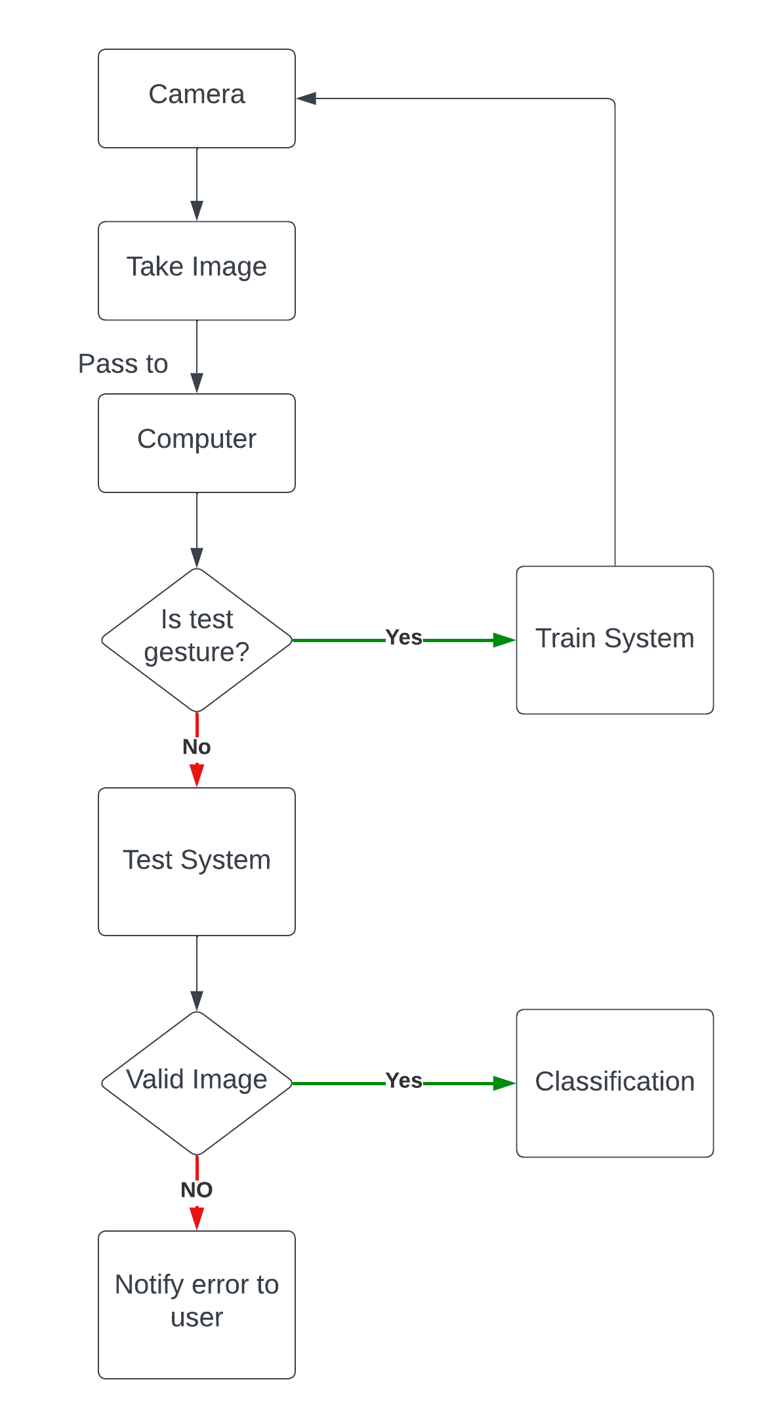
Architecture

Slide 8
References
S. Bilal, R. Akmeliawati, A. A. Shafie, and M. J. E. Salami
Title: Modeling of Human Upper Body for Sign Language Recognition
Source: 5th International Conference on Automation Robotics and Applications (ICARA)
Pages: 104 – 108
Year: 2011
https://www.researchgate.net/publication/220774387_Modeling_of_Human_Upper_Body_for_Sign_Language_Recognition
https://www.researchgate.net/publication/261429003_Novel_segmentation_algorithm_for_hand_gesture_recognition

Slide 9
Thank you and Any Queries

